Slide 1
Lighting Strategy for PQI Conference Room

Slide 2
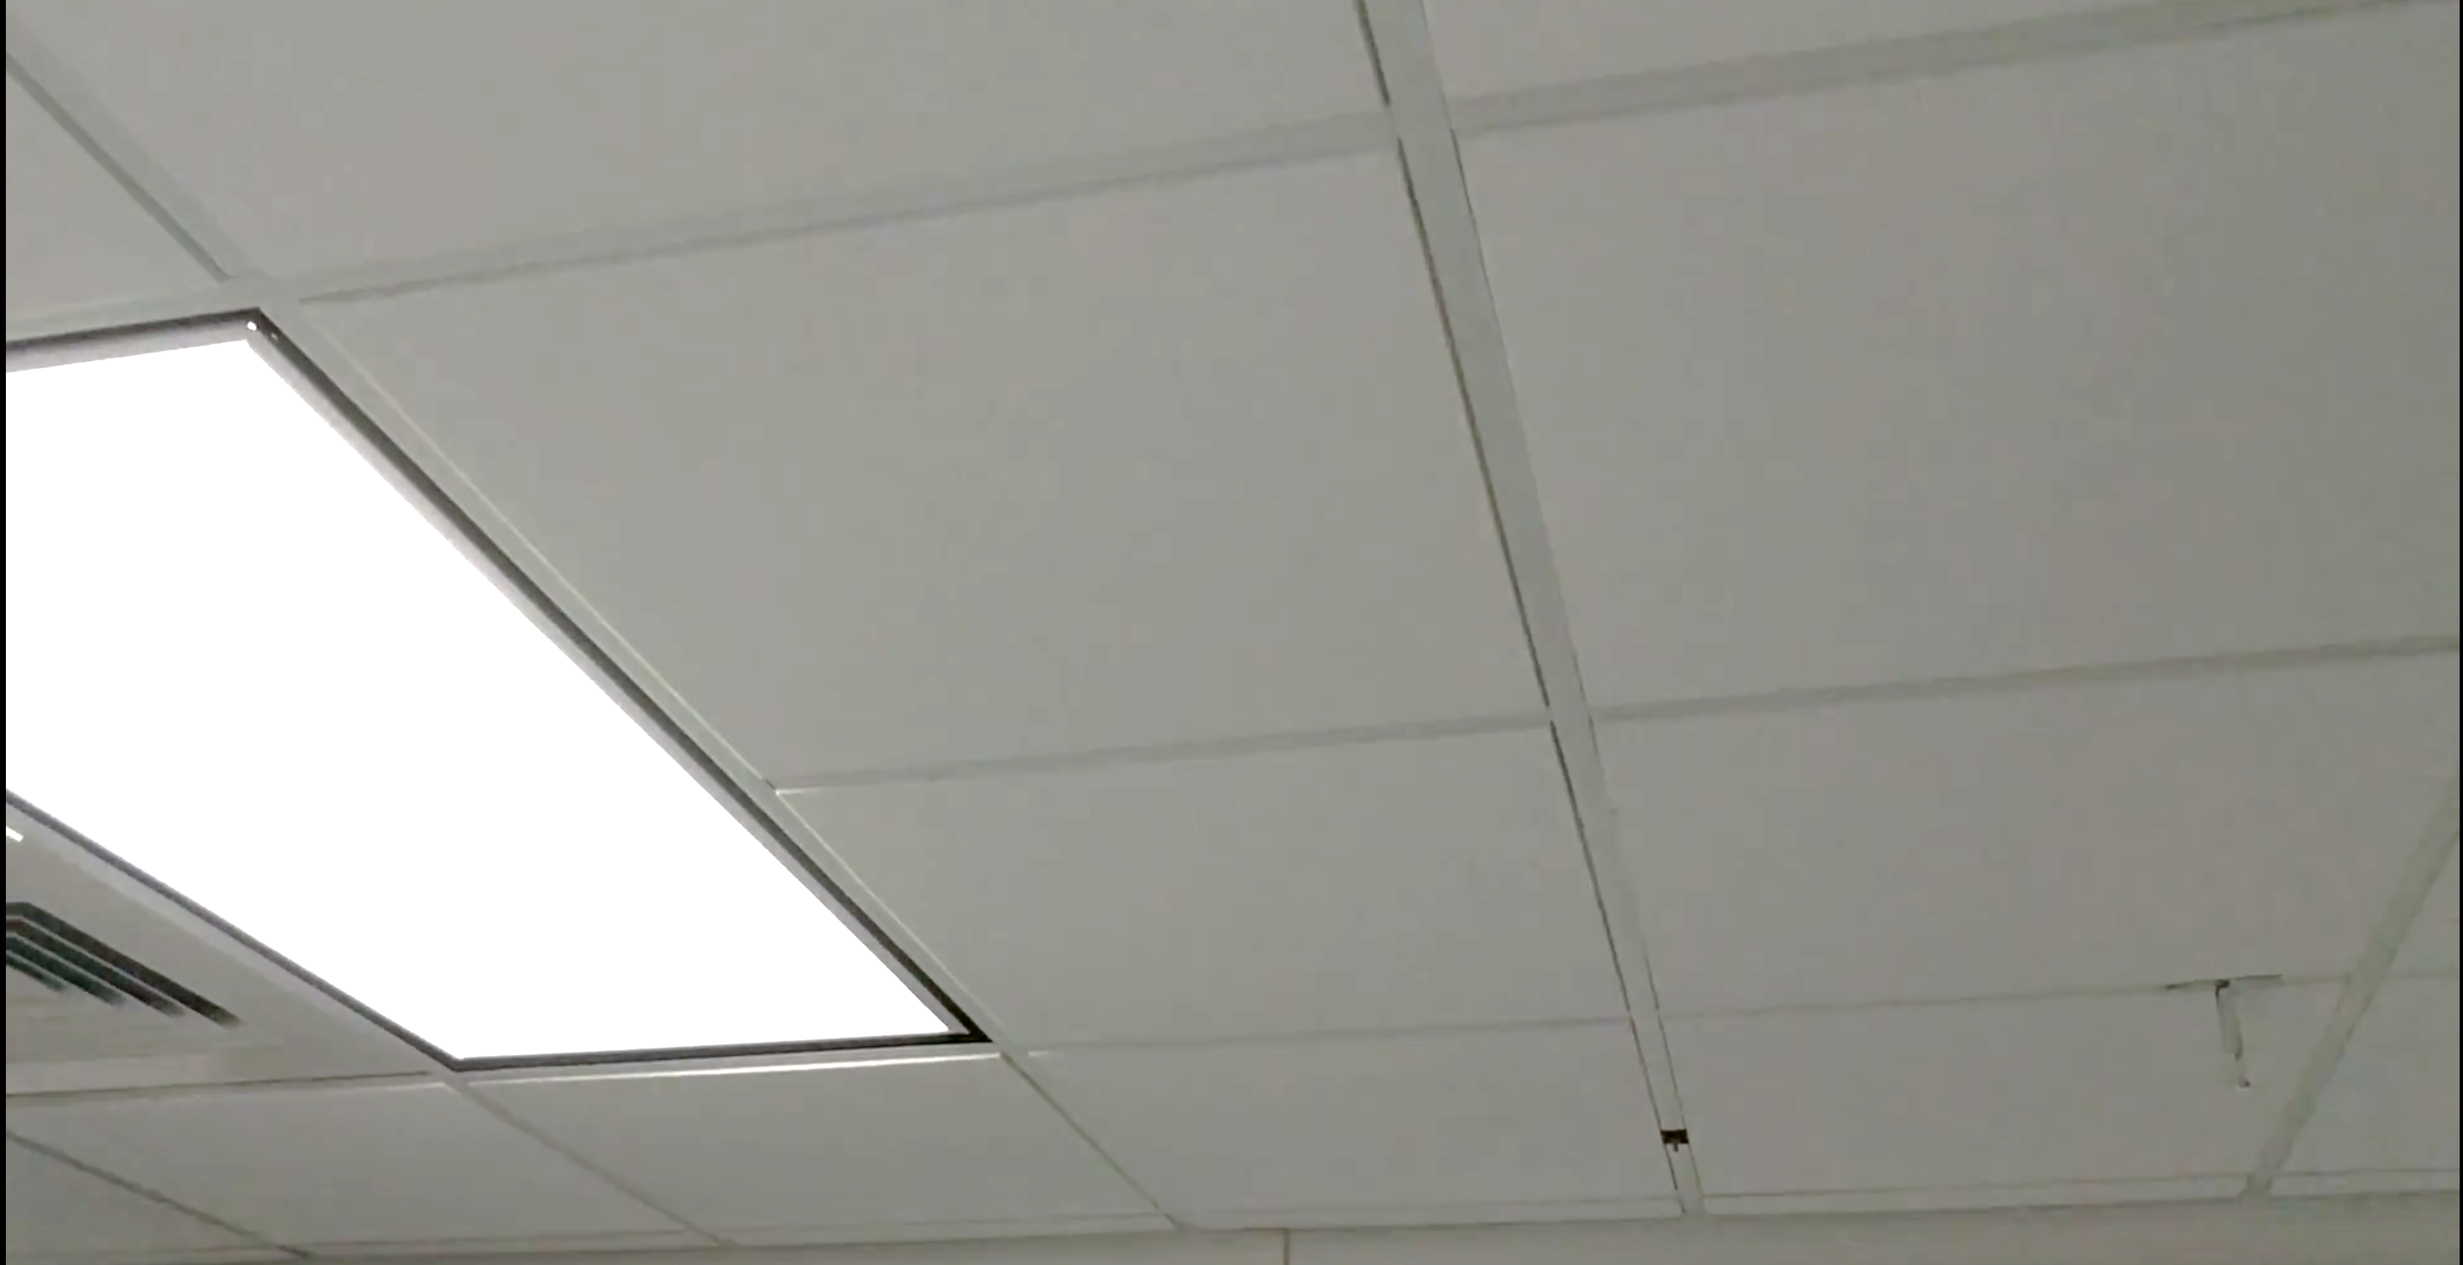

Slide 3
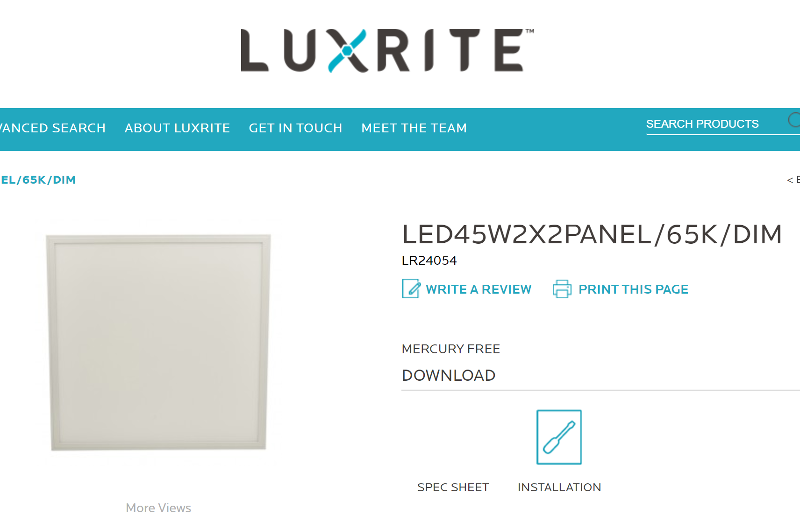
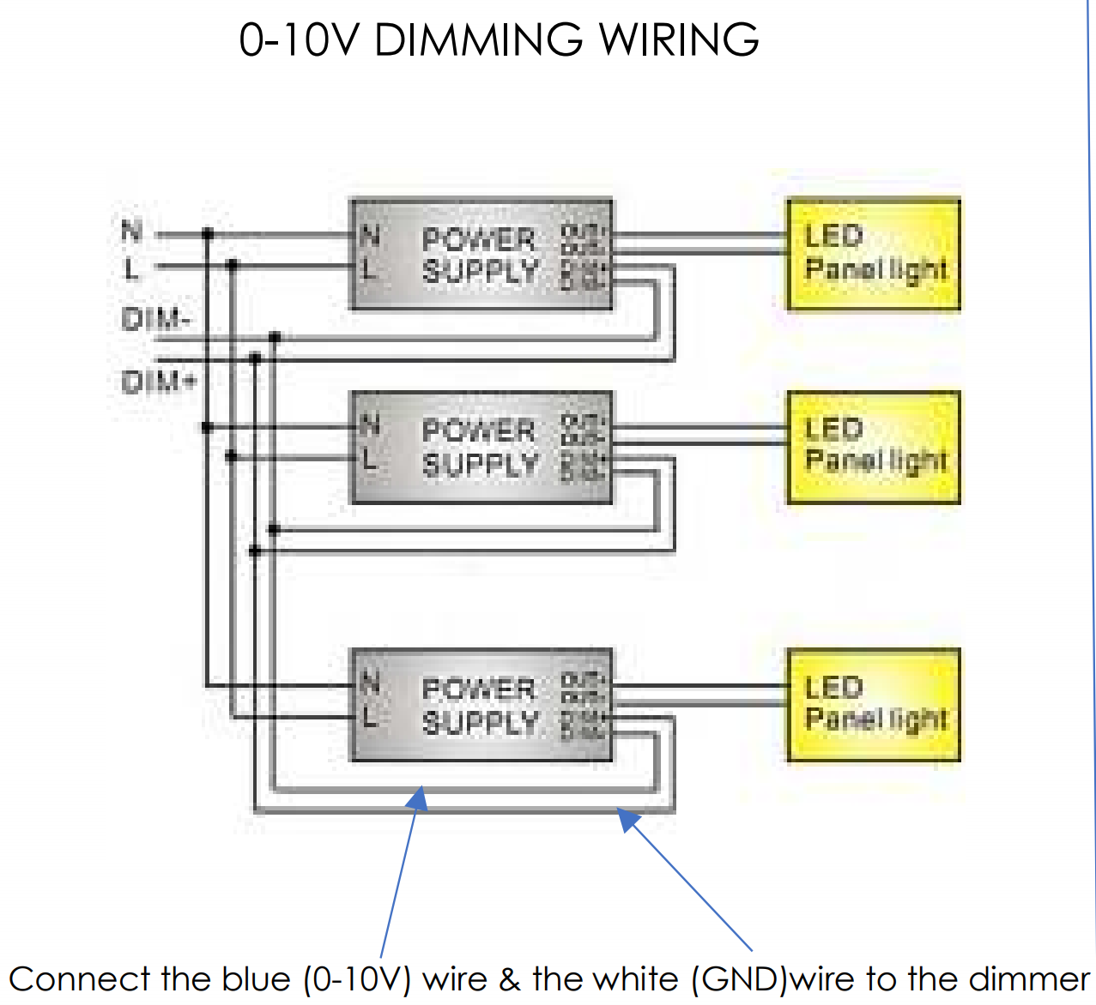

Slide 4
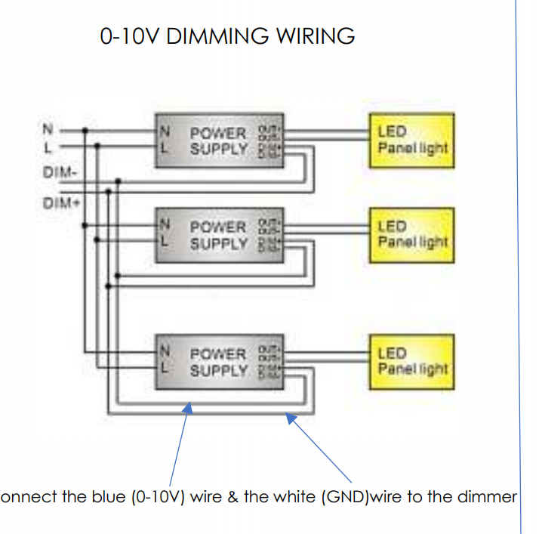
110 Vac power

Slide 5
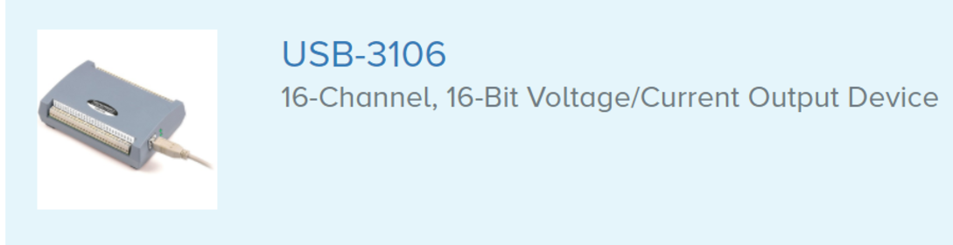
0-10 V dimmer

Slide 6
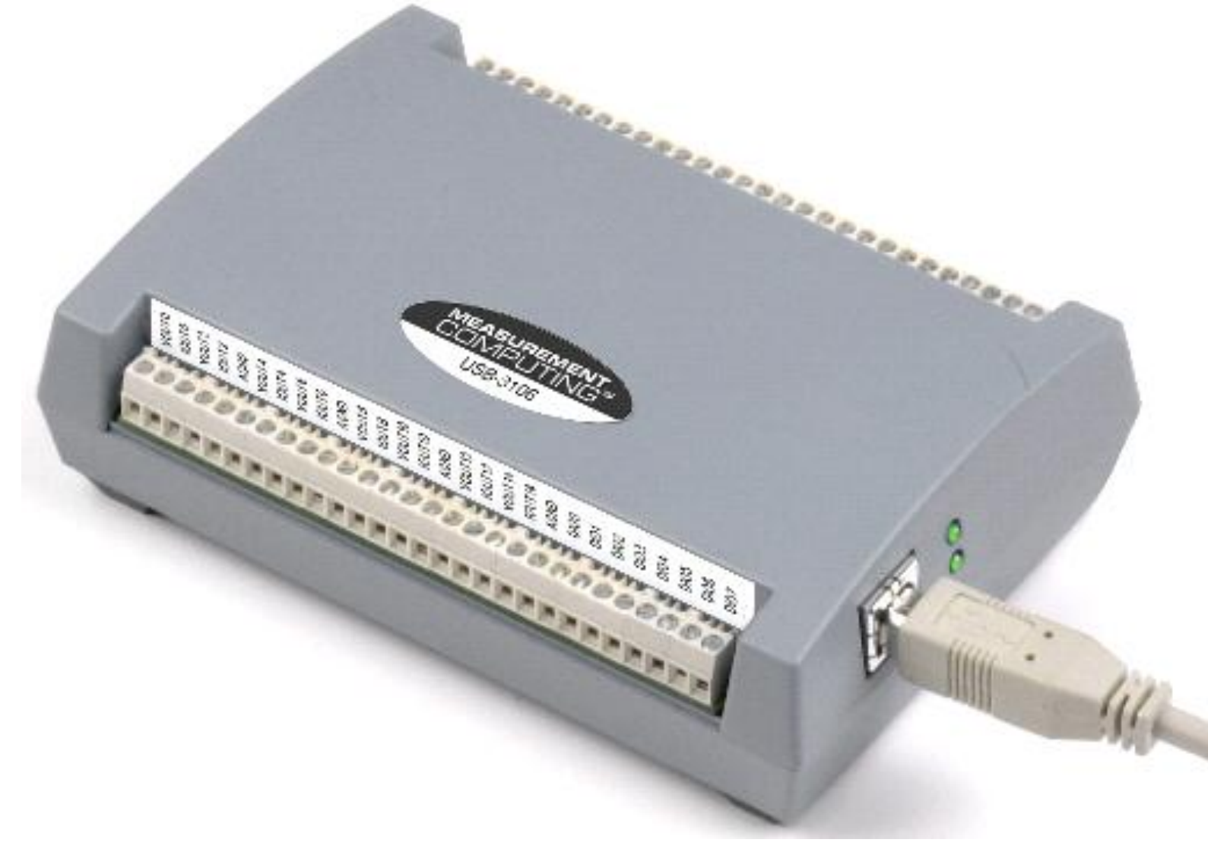
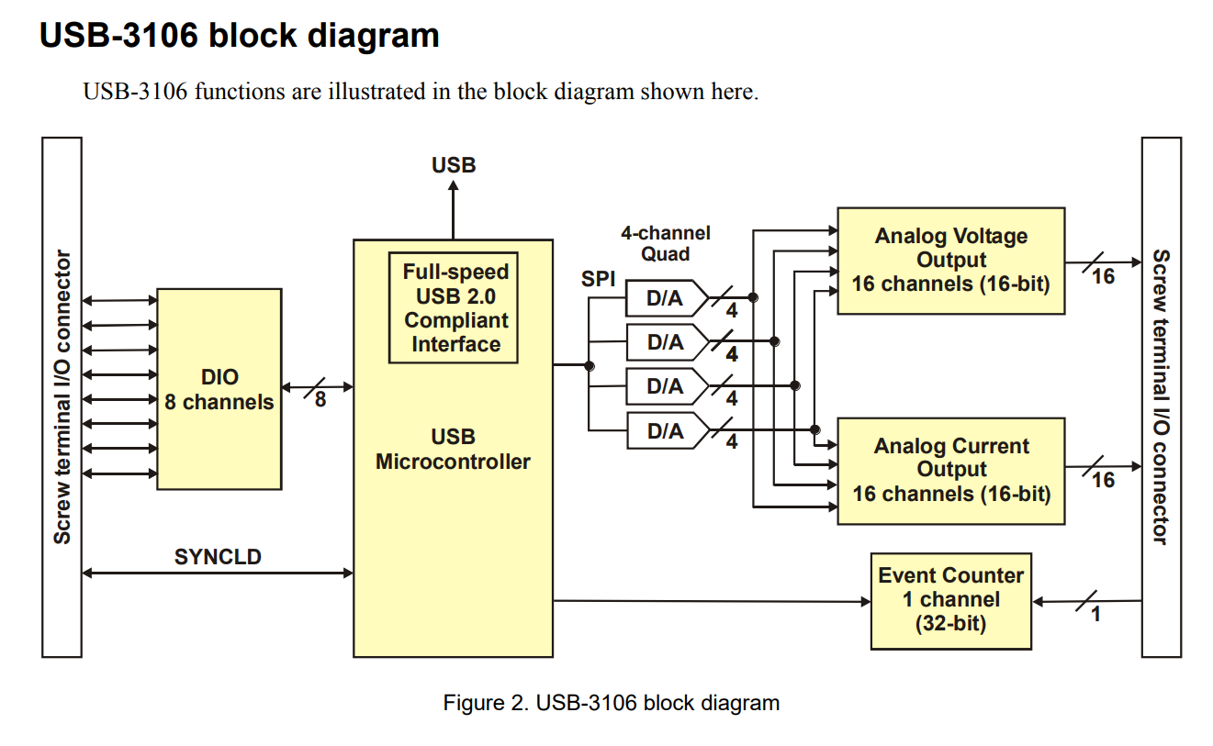

Slide 7
Questions
How to connect power?
All can probably feed off a single outlet
Wiring question
How to route dimmer lines?
Wiring question
One RJ-45 can route four lights (3 + 1 spare)
Need box to patch lines to USB DAC

